Slide 1
Software Process Models
Instructor: Mehroze Khan

Slide 2
Software Life Cycle
Software development usually involves the following stages:
Requirements analysis and definition
System design
Program design
Writing the programs (program implementation)
Unit testing
Integration testing
System testing
System delivery
Maintenance

Slide 3
Software Development Process Models
Waterfall model
Classical
With prototyping
V model
Prototyping model
Phased development: increments and iterations
Spiral model
Unified process
Rapid Application Development (RAD)
Agile methods
XP
Scrum
Kanban

Slide 4
The Spiral Model
Suggested by Boehm (1988)
Combines development activities with risk management to minimize and control risks
The model is presented as a spiral in which each iteration is represented by a circuit around four major activities
Plan
Determine goals, alternatives and constraints
Evaluate alternatives and risks
Develop and test

Slide 5
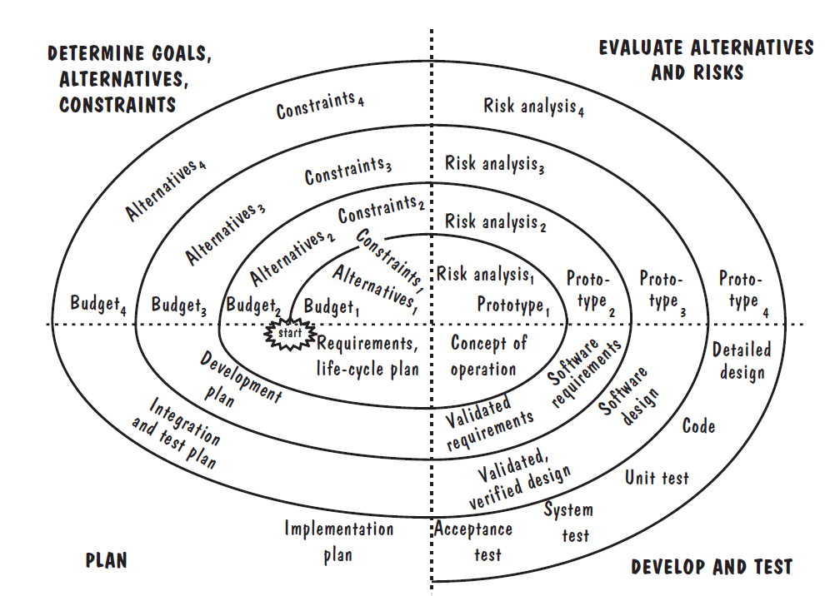
Evolutionary Process Model: The Spiral Model
Notes:
Beginning with the requirements and an initial plan for development (including a budget, constraints, and alternatives for staffing, design, and development environment), the process inserts a step to evaluate risks and prototype alternatives before a “concept of operations” document is produced to describe at a high level how the system should work. From that document, a set of requirements is specified and scrutinized to ensure that the requirements are as complete and consistent as possible.

Slide 6
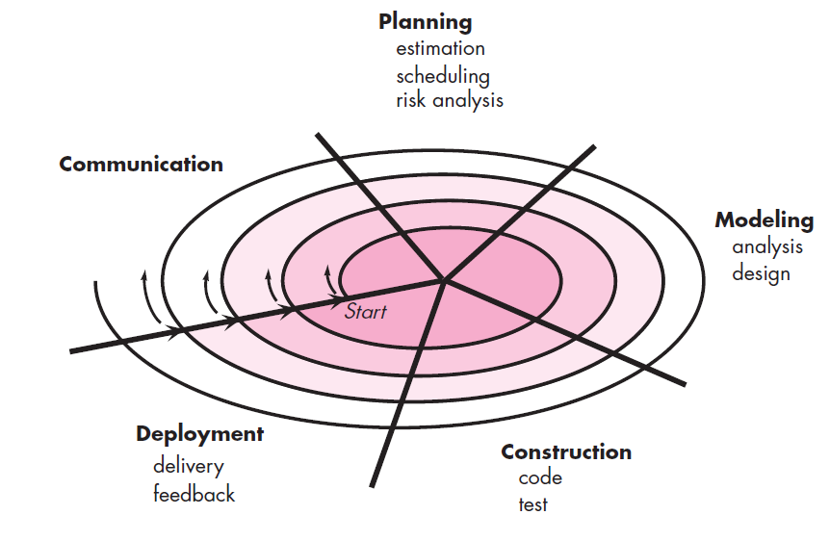
Evolutionary Process Model: The Spiral Model

Slide 7
Evolutionary Process Model: The Spiral Model
The spiral model is an evolutionary software process model that couples the iterative nature of prototyping with the controlled and systematic aspects of the waterfall model.
Using the spiral model, software is developed in a series of evolutionary releases. During early iterations, the release might be a model or prototype. During later iterations, increasingly more complete versions of the engineered system are produced.
Each of the framework activities represent one segment of the spiral path. The software team performs activities that are implied by a circuit around the spiral in a clockwise direction, beginning at the center.

Slide 8
Evolutionary Process Model: The Spiral Model
Risk is considered as each revolution is made.
Anchor point milestones—a combination of work products and conditions that are attained along the path of the spiral—are noted for each evolutionary pass.
The first circuit around the spiral might result in the development of a product specification
Subsequent passes around the spiral might be used to develop a prototype
Then progressively more sophisticated versions of the software.

Slide 9
Spiral Model
Pros:
There is continuous customer involvement.
Development risks are managed.
It is suitable for large, complex projects.
It works well for extensible products.
Cons:
Risk analysis failures can doom the project.
The project may be hard to manage.
It requires an expert development team.

Slide 10
Unified Process Model
Offered by Rational/IBM, UP developed by Booch, Rumbaugh, and Jacobson
UP should be tailored to organizational and project needs
Highly iterative life cycle
Project will be use-case driven and modeled using UML

Slide 11
Unified Process Model
UP life cycle:
Includes five phases which consist of iterations
Iterations are “mini-projects”
Inception:
Fundamental business requirements are described through a set of preliminary use cases.
Planning identifies resources, assesses major risks, and defines a preliminary schedule for the software increments.
Elaboration:
Refines and expands the preliminary use cases and creates an architectural baseline.
Modifications to the plan are often made at this time.

Slide 12
Unified Process Model
Construction:
All necessary and required features and functions for the software increment (i.e., the release) are implemented in source code.
As components are being implemented, unit tests are designed and executed for each.
Integration activities (component assembly and integration testing) are conducted.
Use cases are used to derive a suite of acceptance tests.
Transition:
Software and supporting documentation is given to end users for beta testing
User feedback reports both defects and necessary changes.

Slide 13
Unified Process Model
Production:
Ongoing use of the software is monitored.
Support for the operating environment is provided
Defect reports and requests for changes are submitted and evaluated.

Slide 14
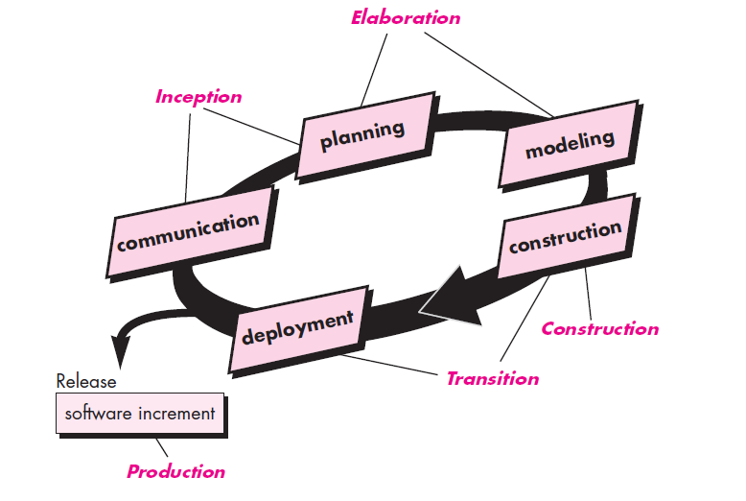
Unified Process Model

Slide 15
Unified Process Model
It is likely that at the same time the construction, transition, and production phases are being conducted, work may have already begun on the next software increment.
This means that the five UP phases do not occur in a sequence, but rather with staggered concurrency.

Slide 16
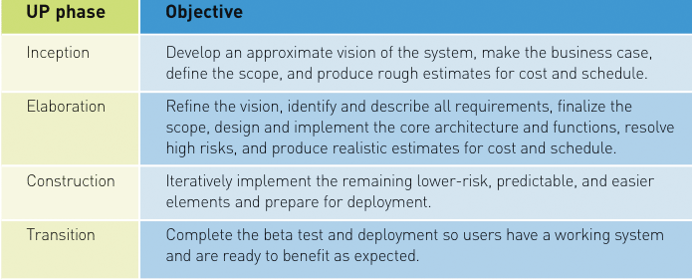
Unified Process Model
Image Source: Systems Analysis and Design in a Changing World, 4th Edition

Slide 17
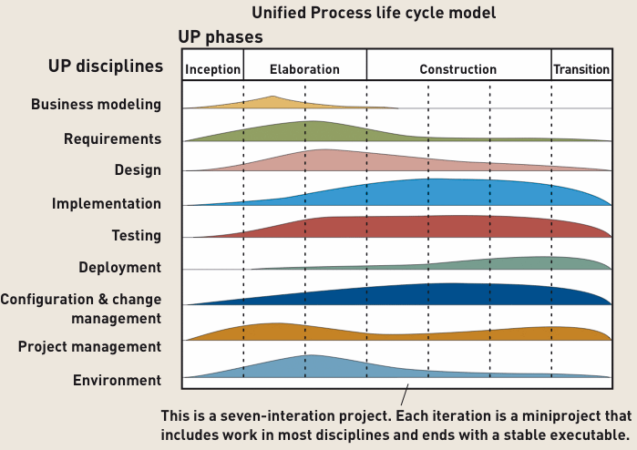
Unified Process Model

Slide 18
Unified Process Model
Pros:
Quality documentation is emphasized.
There is continuous customer involvement.
It accommodates requirements changes.
It works well for maintenance projects.
Cons:
Use cases are not always precise.
Overlapping phases can cause problems.
It requires an expert development team.

Slide 19
Rapid Application Development (RAD) Model
RAD is a linear sequential software development process model.
It emphasizes a concise development cycle using an element-based construction approach.
If the requirements are well understood and described, and the project scope is a constraint, the RAD process enables a development team to create a fully functional system within a concise time period.

Slide 20
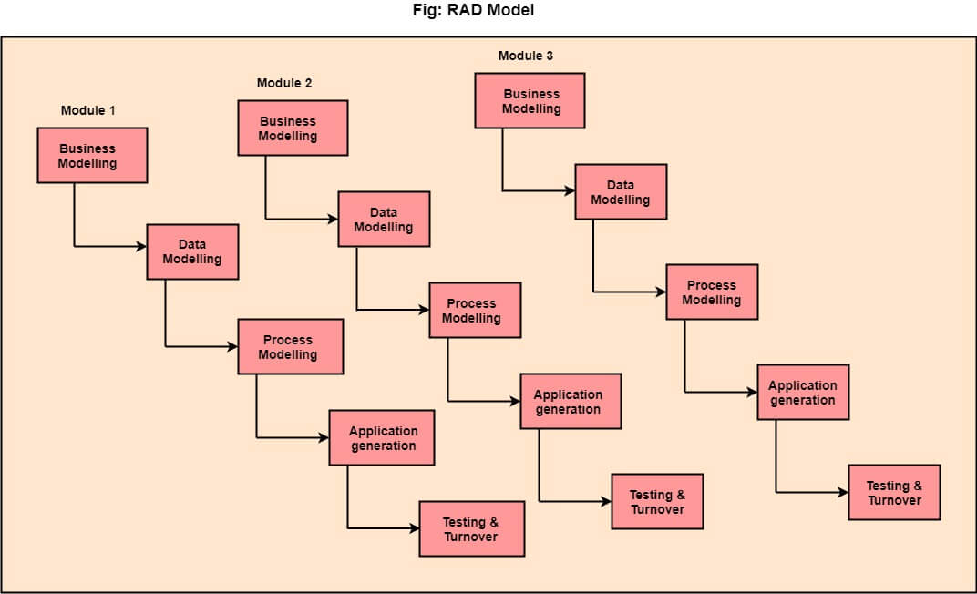
RAD Model

Slide 21
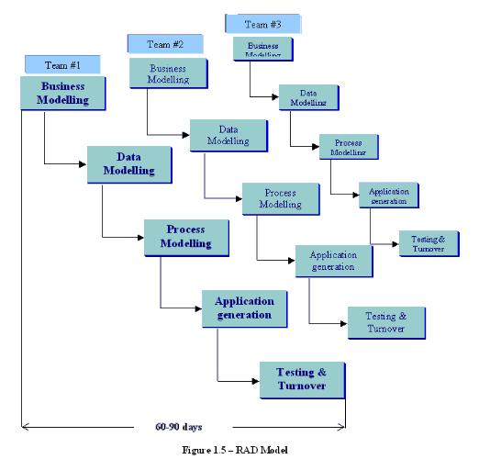
RAD Model

Slide 22
Phases of RAD Model
Business Modelling: The business model for the product under development is designed in terms of flow of information and the distribution of information between various business channels. A complete business analysis is performed to find the vital information for business.
Data Modelling: The data collected from business modeling is refined into a set of data objects (entities) that are needed to support the business. The attributes (character of each entity) are identified, and the relation between these data objects (entities) is defined.
Process Modelling: The information object defined in the data modeling phase are transformed to achieve the data flow necessary to implement a business function. Processing descriptions are created for adding, modifying, deleting, or retrieving a data object.

Slide 23
Phases of RAD Model
Application Generation: The actual system is built and coding is done by using automation tools to convert process and data models into actual prototypes.
Testing & Turnover: The overall testing time is reduced in the RAD model as the prototypes are independently tested during every iteration. However, the data flow and the interfaces between all the components need to be thoroughly tested with complete test coverage. Since most of the programming components have already been tested, it reduces the risk of any major issues.

Slide 24
When to use RAD Model
When the system should need to create the project that modularizes in a short span time (2-3 months).
When the requirements are well-known.
When the technical risk is limited.
Progress needs to be made visible

Slide 25
RAD Model
Pros:
Encourages and prioritizes customer feedback.
It reduced development time.
It increases the reusability of features.
Cons:
It requires highly skilled designers.
Only suitable for projects which have a small development time.
Only systems which can be modularized can be developed using Rapid application development.
On the high technical risk, it's not suitable.
Required user involvement.

Slide 26
References
Shari PFleeger, Joanne Atlee, Software Engineering: Theory and Practice, 4th Edition
Roger S. Pressman, Software Engineering A Practitioner’s Approach, 9th Edition. McGrawHill

